Slide 1


JIM SAMUEL
PRINCIPAL, CAPITOL INTEGRITY GROUP
American Chemistry Council
25th Anniversary Responsible Care Conference
May 8, 2013 Hollywood, FL

Slide 2
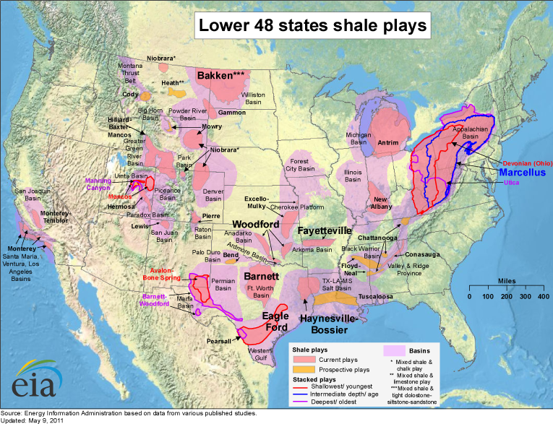
Some Basic Geology/Geography
Notes:
We aren't the only play, but we are amidst the largest.

Slide 3
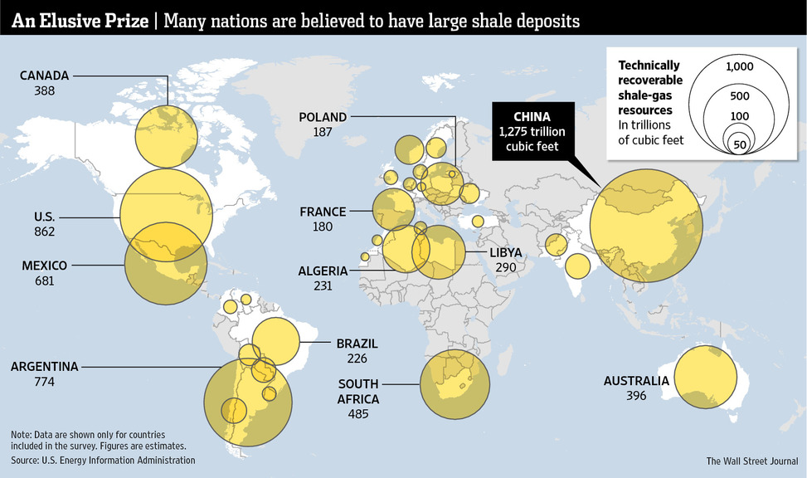
Shale development could be worldwide.
EIA Numbers
Source: Wall Street Journal, December 3, 2012
Notes:
Some overlap of the two.

Slide 4
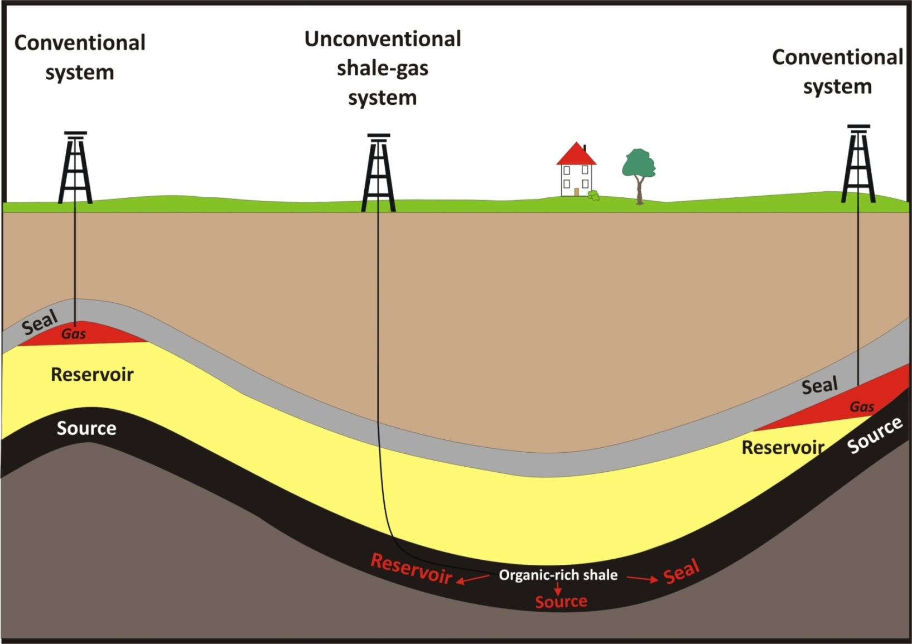
Why is this so different?
3-6%
3-6%
Kostelnich (2010) modified from Schmoker & Oscarson (1995)
Notes:
Thorla McKee well 1814.

Slide 5
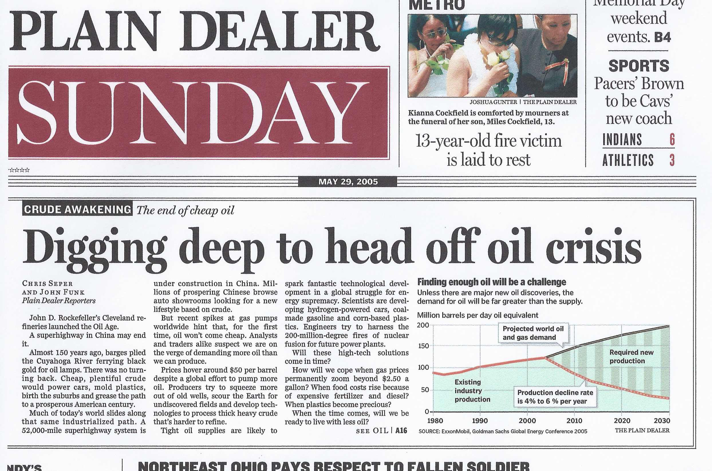
“U.S. oil production began an irreversible decline 30 years ago …. Analysts predict oil production in other nations outside of the Organization of Petroleum Exporting Countries will begin a similar decline this decade.”
[…]
“Demand typically increases by about 2 percent a year, according to government agencies and most analysts. At the same time, production at the world’s oil and gas fields is declining 4 percent to 6 percent a year,…”
Notes:
Some overlap of the two.

Slide 6
Notes:
Some overlap of the two.

Slide 7
U.S. Shale Gas Production has Grown Dramatically
History
2011
Projections
Shale gas
Non-associated offshore
Tight gas
Alaska
Coalbed methane
Associated with oil
Non-associated onshore
Trillion cubic feet.
Source: EIA, Annual Energy Outlook 2013 Early Release.
Notes:
Energy Information Administration

Slide 8
U.S. Shale Gas Production has Grown Dramatically
Billion cubic feet per day.
Sources: LCI Energy Insight gross withdrawal estimates as of January 2013 and converted to dry production estimates with EIA-calculated average gross-to-dry shrinkage factors by state and/or shale play.

Slide 9
U.S. tight oil production has also grown.
History
2011
Projections
STEO Feb. 2013 U.S. crude oil projection
Tight oil
Other lower 48 onshore
Lower 48 offshore
Alaska
U.S. crude oil production in million barrels per day.
Source: EIA, Annual Energy Outlook 2013 Early Release and Short-Term Energy Outlook, February 2013
Notes:
Some overlap of the two.

Slide 10
U.S. tight oil production has also grown.
U.S. tight oil production for select plays in million barrels per day
Source: Drilling Info (formerly HPDI), Texas RRC, North Dakota department of mineral resources, and EIA, through October 2012.
Notes:
Some overlap of the two.

Slide 11
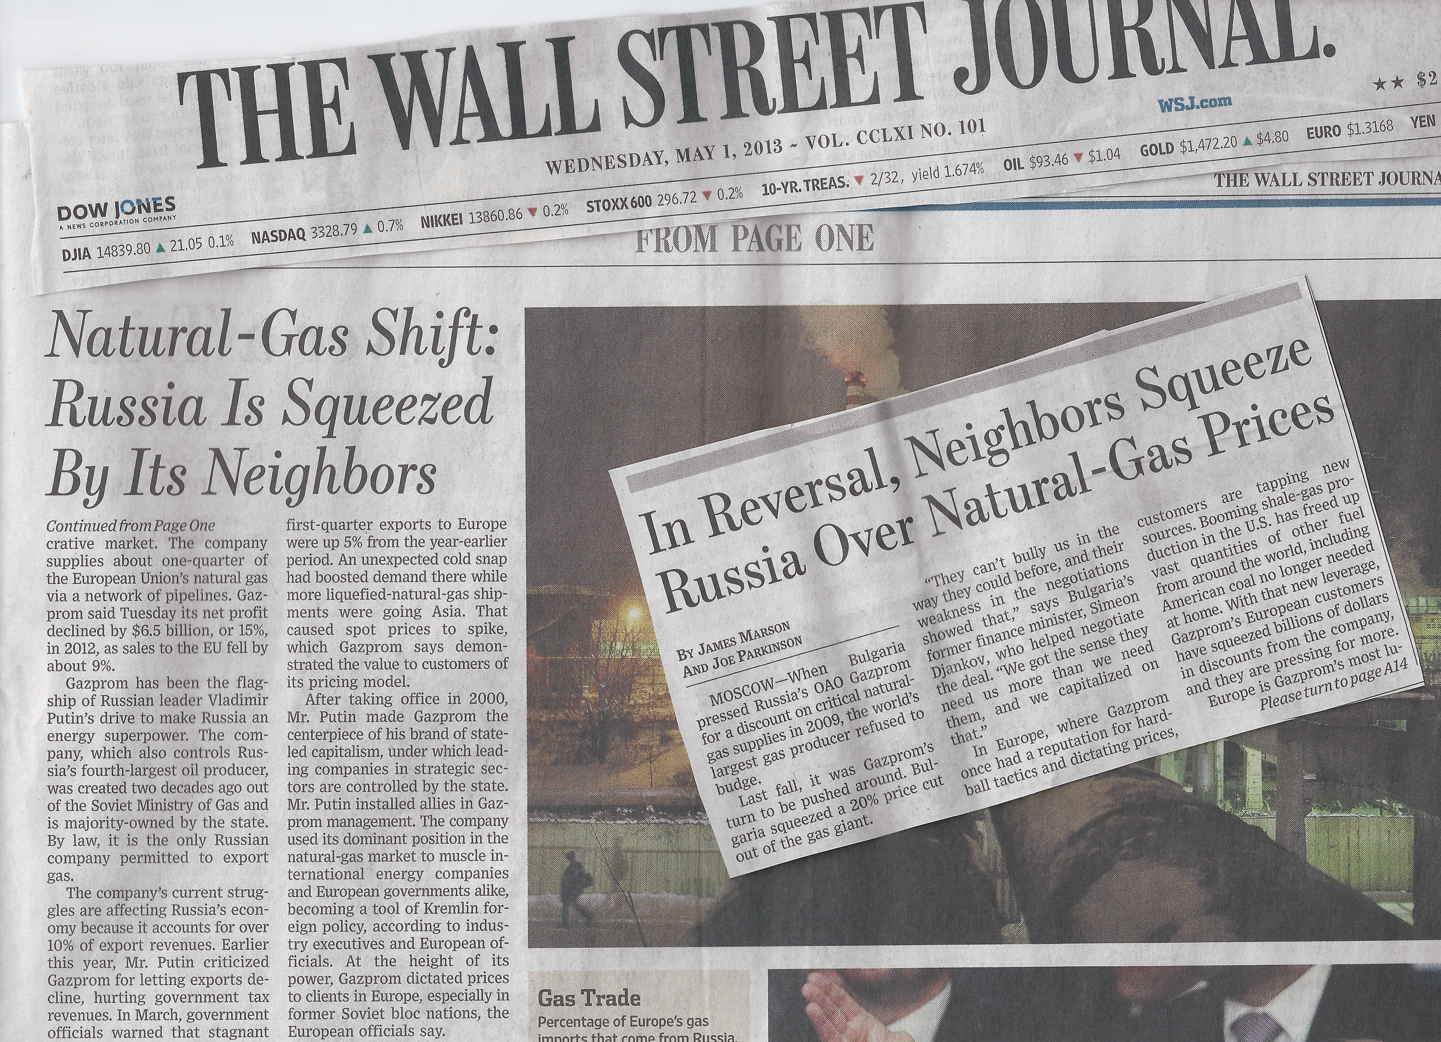
In October, Mr. Putin called on Gazprom to adapt its strategy in response to what he called the “shale revolution.”
[…]
“By 2010, the U.S. unexpectedly had supplanted Russia as the world’s largest natural-gas producer.”
Notes:
Some overlap of the two.

Slide 12
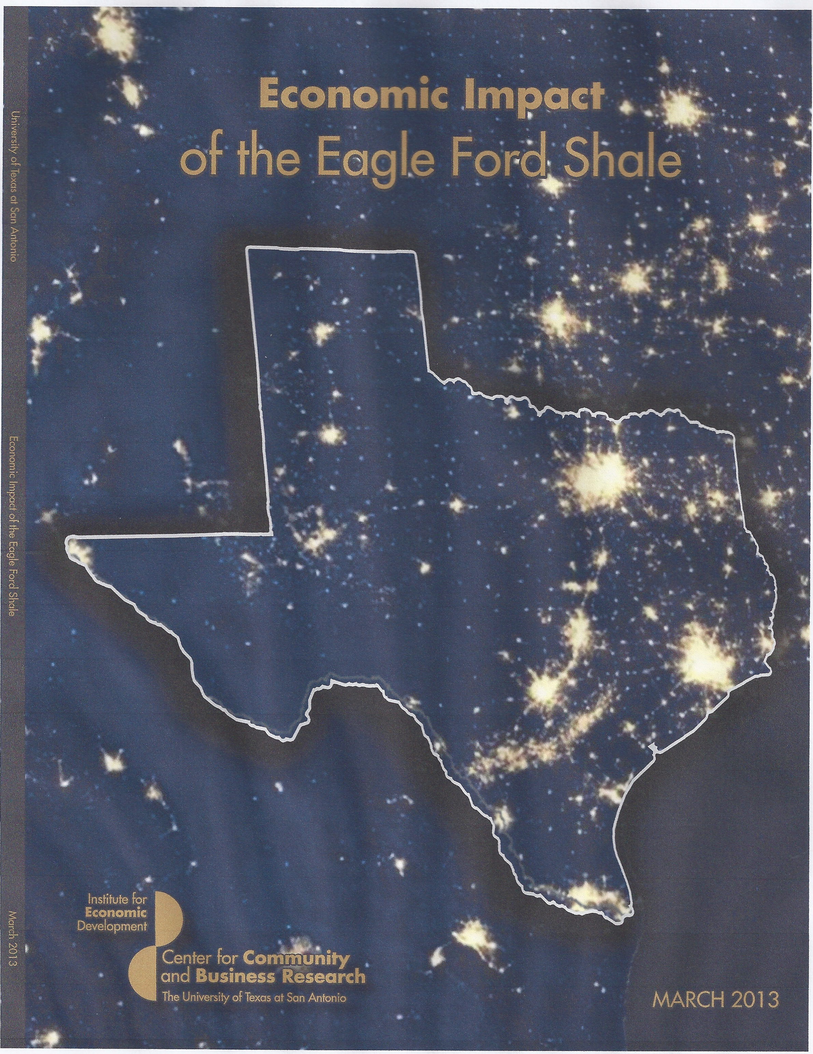
Economic Impact Studies

Slide 13
Economic Impact - Utica
65,680 Related Jobs
$4.9 Billion in value added growth
$433 million in new State & Local taxes
…in Ohio by 2014
Notes:
Broad base of support and funding, not industry. Touched on the great importance of the chemical industry and trucking, but focused on the upstream.

Slide 14
Economic Impact - Utica
$4.9 billion in value added growth means shale-related growth over 3 years will exceed the total average growth rate for Ohio's economy for the past 13 years!
Notes:
Ohio has about a $500 Billion economy. In the 13 strong shale counties, there was an astounding 21.1% increase in total sales activity in 2012 compared to 2011. In raw numbers that's an increase of $2.6 billion of economic activity, rising to $14.9 billion in 2012 from $12.3 billion in 2011.

Slide 15
Economic Impact Studies

Slide 16
Economic Impact – Eagle Ford
2012 impact on a 20-county region showed
$61 billion economic impact
116,000 related jobs
Notes:
The study projects that the region will support 127,000 jobs and produce an economic impact of $89 billion for Texas in 2022.
The Center for Community and Business Research (CCBR) estimated that close to $19 billion was spent on capital expenditures in 2012.
Wood Mackenzie Ltd.1 recently calculated that oil and gas companies will spend $28 billion in the South Texas Eagle Ford play during 2013.

Slide 17
Economic Impacts
The “Boom-to-Bust” Cycle or “Boom-to-Boom”?
Real or perceived? It’s about timing, location and technology.
As drilling becomes production, jobs and economics change.
Regional goal to create sustainable economic impact up and down the supply chain and industry stream.
Notes:
Upstream – Midstream – Downstream
Midstream investments – chem comp

Slide 18
THANK YOU
Capitolintegrity.com
NEIenergy.org

